Slide 1
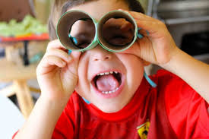
Get ready to explore the guide!

Slide 2

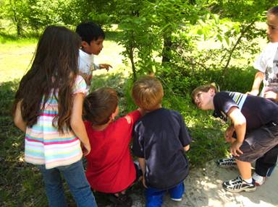
Contact Information
Cindy Peterson
Montana PLT Coordinator
cindy.peterson@umontana.edu
Jackie Stallard
National PLT Office
jstallard@forestfoundation.org

Slide 3
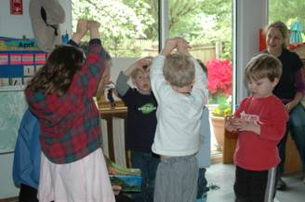
History of PLT and Early Childhood
Revised PreK-8 Environmental Education
Activity Guide (1993)
Minnesota and Wisconsin develop Early
Childhood Supplements to PLT (2002)
PLT forms National EC Advisory Committee (2008)
EC Activity drafts shared
at PLT Conference
(May 2009)
Begin EC Workshops
Nationwide (Fall 2009)
PLT releases Environmental Experiences
for Early Childhood (Jan 2010)

Slide 4
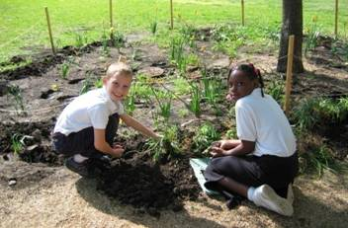
Early Childhood Experiences
Exploring Nature with Five Senses
Touch: Get in Touch with Trees
Taste and Smell: We All Need Trees
Sight: The Shape of Things
Sound: Sounds Around
Meeting Neighborhood Trees
To Be a Tree
Trees as Habitats
Three Cheers for Trees
Experiencing Trees Through Seasons
Spring: Bursting Buds
Summer: Adopt a Tree
Fall: Signs of Fall
Winter: Evergreens In Winter

Slide 5


Music and Movement
Fosters Brain Development
Develops Gross and Fine Motor Skills
Benefits Children with Special Needs
Project Learning Tree:
Early Childhood CD
Supports EC Experiences
Sounds of Nature
Billy B Songs

Slide 6
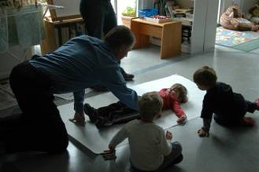
Activity Components
Title
Sidebar
Background for Educators
Introducing the Theme
Featured Experience
Group Experiences
- Music and Movement
- Branching Out with Books
- Snacks
- Neighborhood Nature Walks
Learning Centers
- Art
- Outdoor Explorers
- Discovery Table
- Math and Manipulatives
- Dramatic Play
Family and Friends
Reading Connections

Slide 7

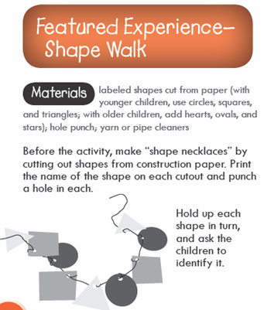
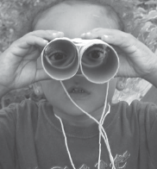
Activity pages

Slide 8

Dance with Leaves
Track 1 on PLT CD

Slide 9

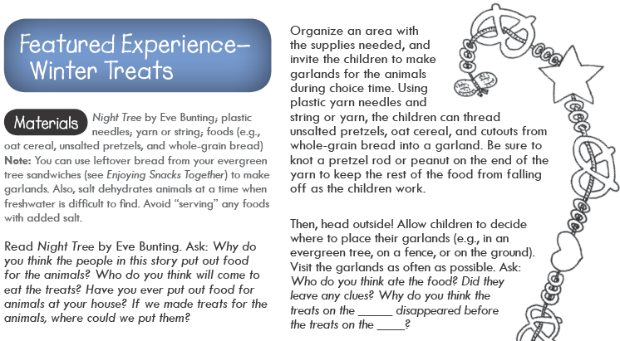
Activity 6 page

Slide 10

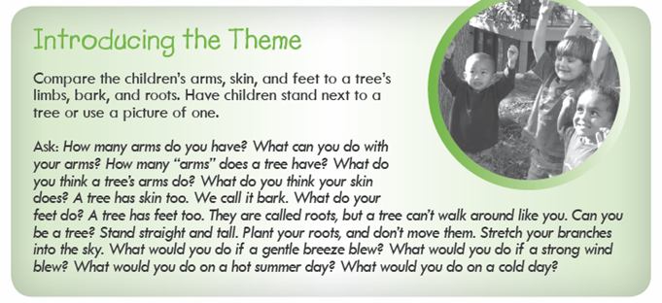
Activity 9 page

Slide 11
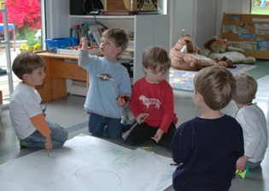
Philosophy and Methods
Go Outside Often
Involve the Use of all Senses
Begin with Simple Experiences
Let Students Use their Imagination
Provide Choices Whenever Possible
Emphasize the Experience – Not the facts
Integrate Music and Movement, Art, and Literature
Keep Children Actively Involved – They Learn from Play
Engage Parents to Continue Learning Activities at Home

Slide 12
Discussion Questions
What groups should be identified as target audiences for this supplement?
What opportunities exist to implement workshops at your location?
Who are some potential partners?

