Slide 1
RadSat Radiation Tolerant SmallSat Computer System (Paper No: SSC15-X-8)
Presenter
Dr. Brock J. LaMeres
Associate Professor
Electrical & Computer Engineering
Authors
Montana State University
B.J. LaMeres, S. Harkness, M. Handley, P. Moholt, C. Julien, T. Kaiser, D. Klumpar, K. Mashburn, L. Springer NASA Goddard Space Flight Center Gary A. Crum

Slide 2
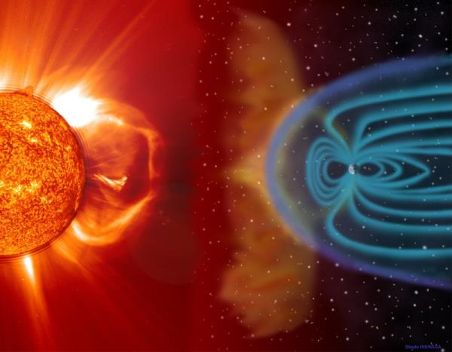
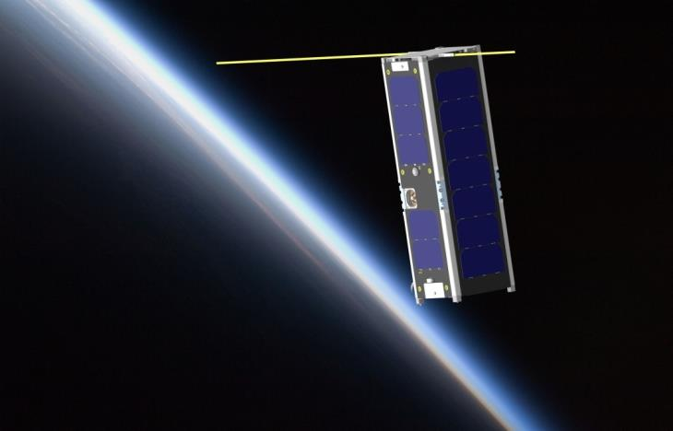
Objective of the RadSat Mission
Demonstrate a Novel Computer Technology in a Space Environment
The computer is implemented on a commercial off-the-shelf (COTS) FPGA.
The computer delivers radiation tolerance through a reconfigurable/redundant architecture.
The computer delivers low cost using COTS parts.
The computer delivers higher performance (computation & power efficiency) by exploiting modern process nodes (28nm).

Slide 3
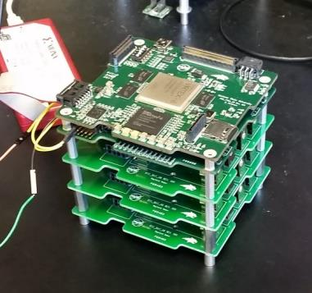
Why Does the SmallSat Community Care?
Computation
SmallSats are doing more and more on-board data processing (e.g., images, sensor data, communications).
Radiation Tolerance
Cutting edge process nodes (28nm) provide increased computation but are becoming more susceptible to radiation induced faults (SEEs).
As SmallSat missions achieve longer duration and move into deep space, radiation becomes more and more of a concern (both TID & SEE).
Cost
Any SmallSat computing solution must be cost effective to align with SmallSat theme. (i.e., “launch more, inexpensive, satellites”)

Slide 4
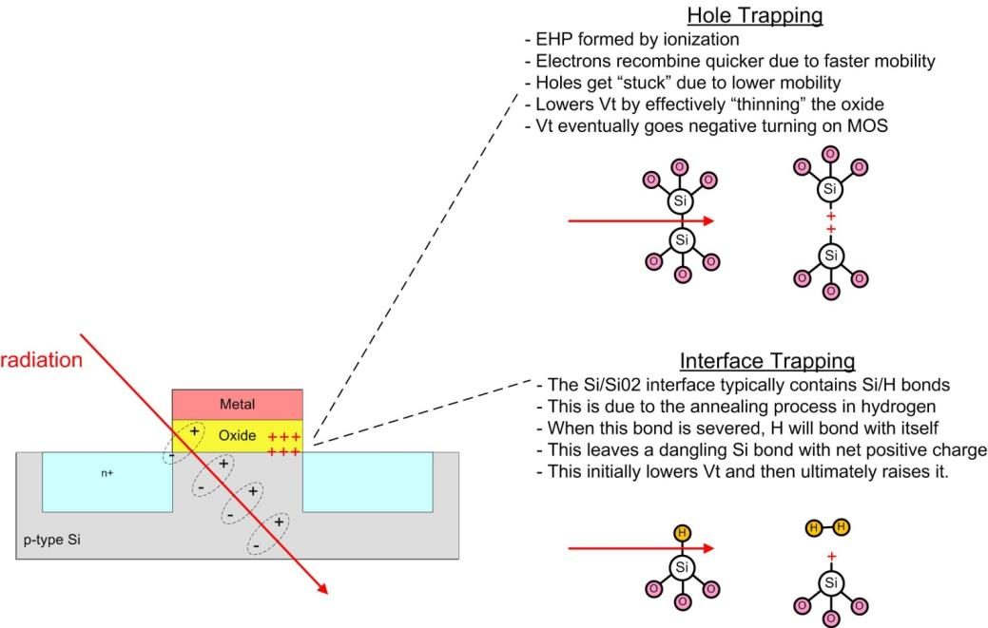
What are the Radiation Effects?
1. Total Ionizing Dose (TID)
Cumulative long term damage due to ionization.
Primarily due to low energy protons and electrons due to higher, more constant flux, particularly when trapped
Oxide Breakdown cases
Threshold Shifts
Leakage Current
Timing Changes

Slide 5
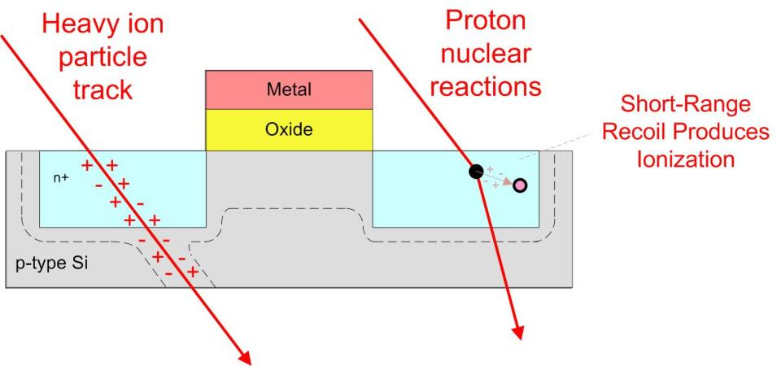
What are the Radiation Effects?
2. Single Event Effects (SEE)
Electron/hole pairs created by a single particle passing through semiconductor.
Primarily due to heavy ions and high energy protons.
Excess charge carriers cause current pulses.
Creates a variety of destructive and non-destructive damage. “Critical Charge” = the amount of charge deposited to change the state of a gate

Slide 6
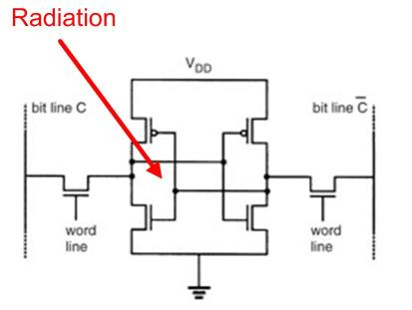
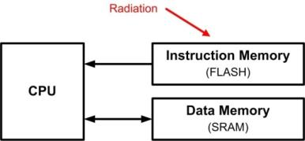
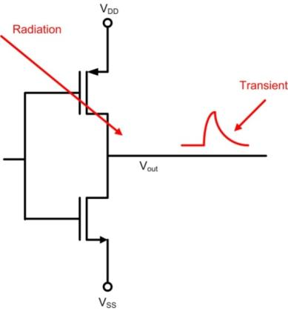
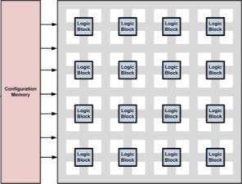
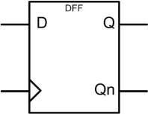
What are the Radiation Effects?
2. Single Event Effects (SEE) Cont…
Radiation
FPGA Fabric
All of these effects occur in FPGAs

Slide 7
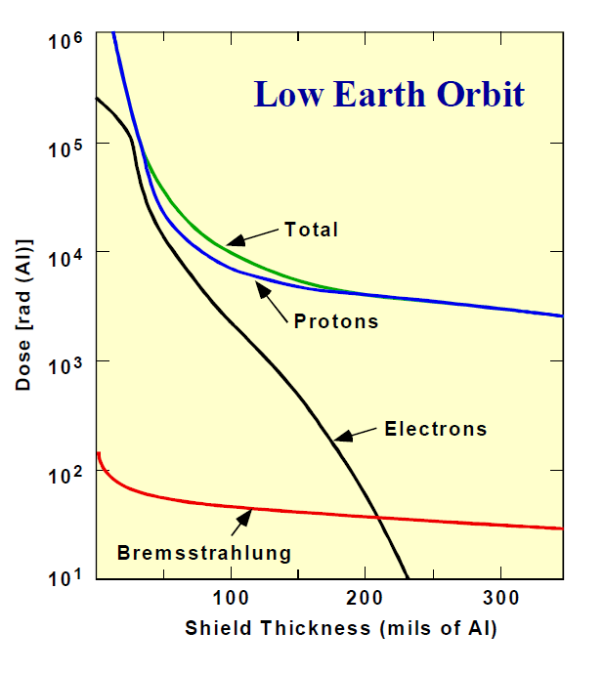
How We Currently Deal with Radiation
Shielding?
It helps, but not has much as you might think…
For higher energy particles, the secondary effects can make the problem worse.

Slide 8
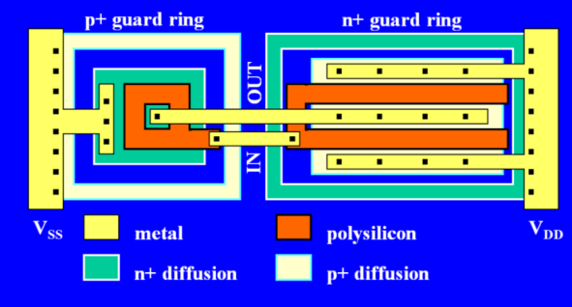
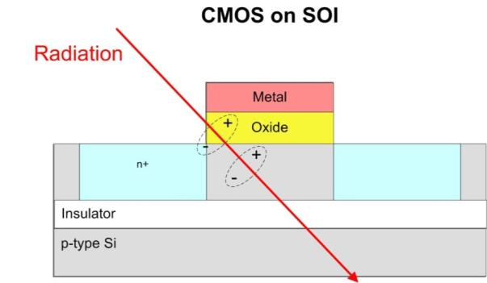
How We Currently Deal with Radiation
Dealing with Total Ionizing Dose
Radiation Hardened by Design (RHBD)
Radiation Hardened by Process (RHBP)

Slide 9
How We Currently Deal with Radiation
Dealing with Total Ionizing Dose
Radiation Hardened by Design (RHBD)
Radiation Hardened by Process (RHBP)
or
Nothing…
If the mission is short enough, TID may not be a concern.

Slide 10
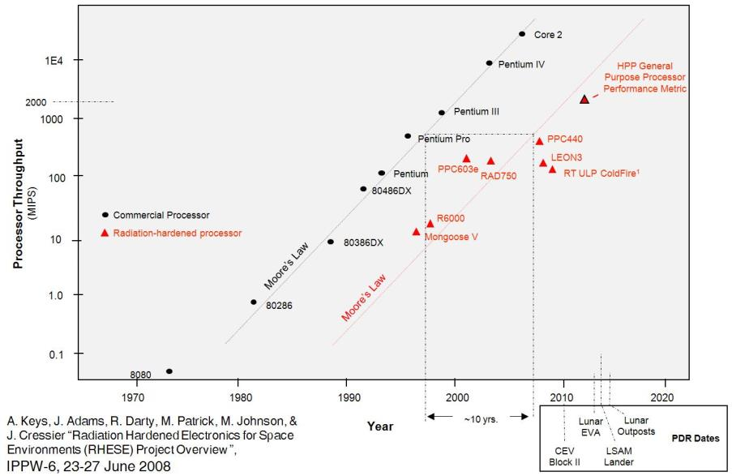
How We Currently Deal with Radiation
Total Ionizing Dose – The Issue with Existing Techniques
The unique processing techniques lowers the volume, which increases cost.
The unique processing techniques reduces the performance.
- Rad-Hardened Processers lag in performance to their commercial counterparts by ~10 years

Slide 11
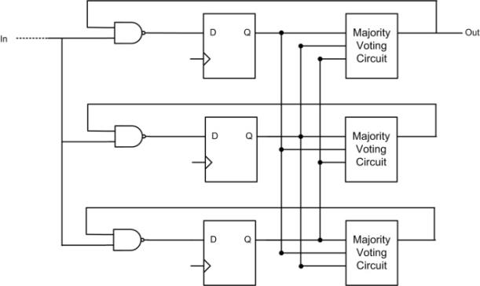
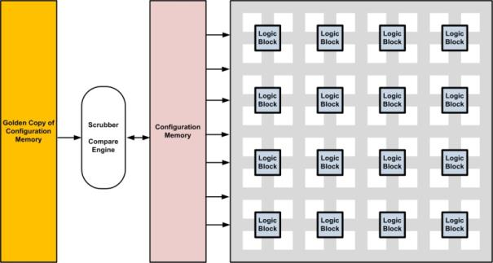
How We Currently Deal with Radiation
Dealing with Single Event Effects
Architecture: Triple Module Redundancy
Triplicate each circuit
Use a majority voter to produces output
Background Memory Checking: Scrubbing
Compare contents of a memory device to a “Golden Copy”
Golden Copy is contained in a radiation immune technology (fuse-based memory, MROM, etc…)
Note: TMR+Scrubbing is the recommended mitigation approach for FPGA-based aerospace computers

Slide 12
How We Currently Deal with Radiation
Dealing with Single Event Effects
Architecture: Triple Module Redundancy
Triplicate each circuit
Use a majority voter to produces output
Background Memory Checking: Scrubbing
Compare contents of a memory device to a “Golden Copy”
Golden Copy is contained in a radiation immune technology (fuse-based memory, MROM, etc…)
Note: TMR+Scrubbing is the recommended mitigation approach for FPGA-based aerospace computers
The issue? It takes resources and care must be taken to get the intended results.

Slide 13
The Current State of Radiation
Radiation vs. Process Node
Larger Transistors
TID is primary concern
SEE isn’t as bad
Slow & Power Hungry
Small Transistors
SEE is primary concern
TID isn’t as bad
Fast & Power Efficient
Xilinx FPGA TID
Virtex-4 ~300 krad
Virtex-5 ~500 krad
Virtex-7 >500 krad _{est}
(Allen, 2014)

Slide 14
The Current State of Radiation
Radiation vs. Process Node
Larger Transistors
TID is primary concern
SEE isn’t as bad
Slow & Power Hungry
What does this mean?
If we use the most recent process node, we get TID tolerance inherently PLUS low cost, high performance, & power efficiency.
Except we need to do something about SEE…
Small Transistors
SEE is primary concern
TID isn’t as bad
Fast & Power Efficient
Xilinx FPGA TID
Virtex-4 ~300 krad
Virtex-5 ~500 krad
Virtex-7 >500 krad _{est}
(Allen, 2014)

Slide 15
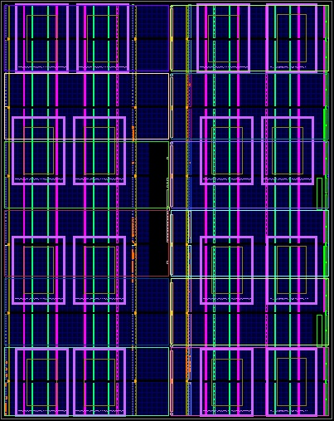
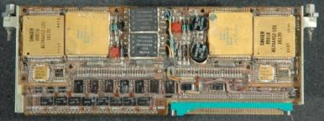
Our Approach
Fault Tolerance Through Abundant Spares
TMR + Spares
3 Tiles run in TMR with the rest reserved as spares
Spatial Avoidance and Background Repair
If TMR detects a fault, the damaged tile is replaced with a spare and foreground operation continues
The tile is “repaired” in the background via partial reconfiguration (PR).
Scrubbing
Blind scrubbing continually runs through tiles (fast)
Readback scrubbing periodically runs through rest of fabric (slower)
External Radiation Sensor
An external spatial radiation sensor provides awareness of potential strike
16 MicroBlaze Processors on Virtex-6
Precedent: Shuttle Flight Computer (TMR + Spare)

Slide 16
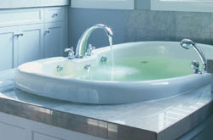
Our Approach
Why do it this way?
With Spares, it basically becomes a flow-problem:
Partial Reconfiguration is faster than Full Reconfiguration.\
Brining on a spare is faster than Partial Reconfiguration.
If the repair rate is faster than the incoming fault rate, you’re safe.
If the repair rate is slightly slower than the incoming fault rate, spares give you additional time.
The additional time can accommodate varying flux rates.
Abundant resources on an FPGA enable dynamic scaling of the number of spares. (e.g., build a bigger tub in real time)

Slide 17
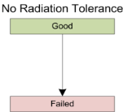
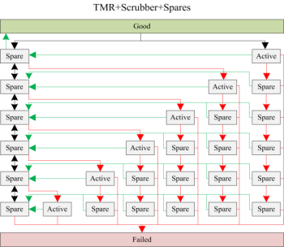
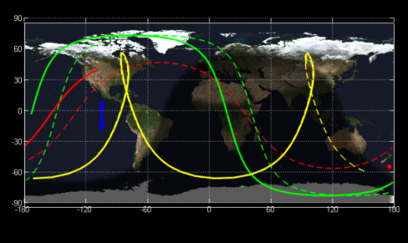
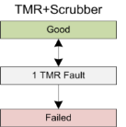
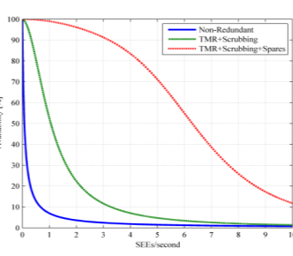
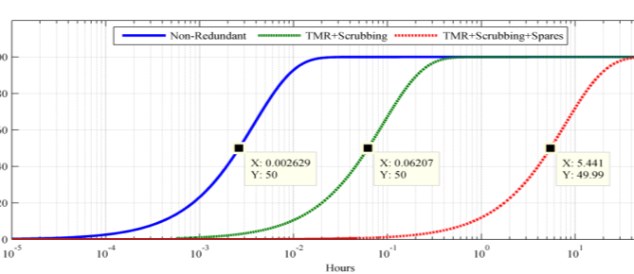
Our Approach
Modeling: Is this an improvement to TMR+Srubbing?
We use a Markov Model to predict Mean-Time-Before-Failure.
We want to see if it improves MTBF over non-redundant & TMR+scrubbing.
The fault rate was extracted from CREME96 for 4 different orbits for Virtex-6 FPGA.
The repair rate was found empirically.
ISS
HEO
HRBE
GEO
Ok, it looks promising…

Slide 18
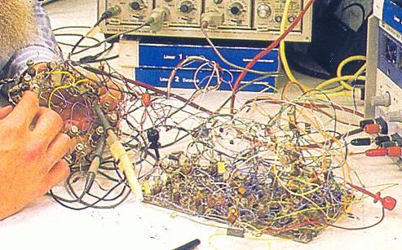
Technology Maturation
Ok, Let’s build it and test it…
Technology Readiness Level (TRL)
TRL 1 – an idea : :
TRL 9 – mission proven

Slide 19
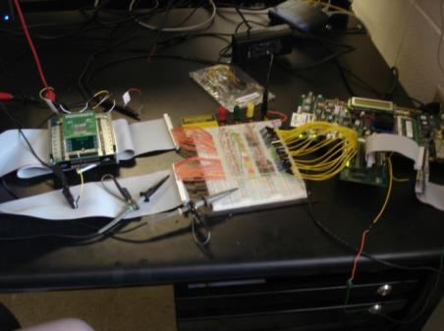
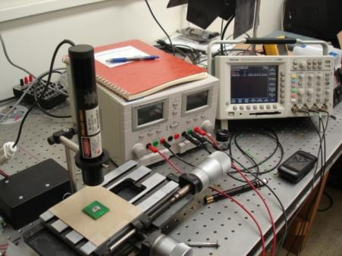
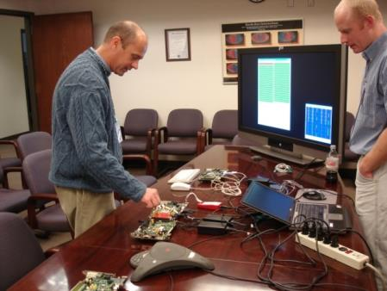
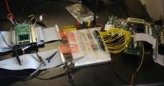
Technical Readiness Level (TRL-1)
Step 1 – Build a Prototype to See if it is Possible
The Montana Space Grant Consortium funds an investigation into conducting radiation tolerant computing research at MSU. The goal is to understand the problem, propose a solution, and build relationships with scientists at NASA.
Clint Gauer (MSEE from MSU 2009) demo’s computer to MSFC Chief of Technology Andrew Keys
Timeline of Activity at MSU
Proof of Concept
(2008-2010)
2008
2009
2010
2011
2012
2013
2014-15
2016
2017

Slide 20
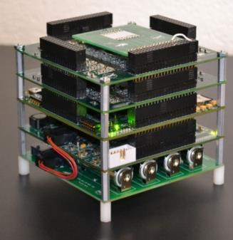
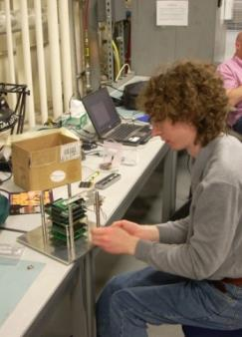
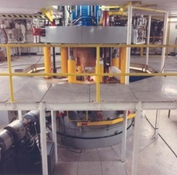
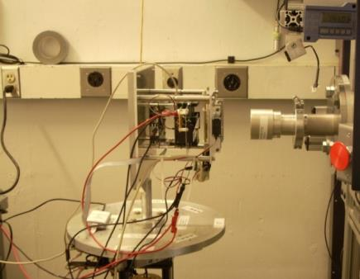
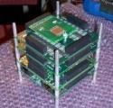
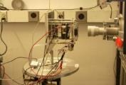
Technical Readiness Level (TRL-3)
Step 2 –Test in a Cyclotron
NASA EPSCoR funds the development of a more functional prototype and testing under bombardment by radiation at the Texas A&M Radiation Effects Facility.
Computer
Ray Weber (Ph.D., EE from MSU, 2014) prepares experiment.
Timeline of Activity at MSU
Proof of Concept
Prototype Development & Cyclotron Testing
(2008-2010)
(2010-2012)
2008
2009
2010
2011
2012
2013
2014-15
2016
2017

Slide 21
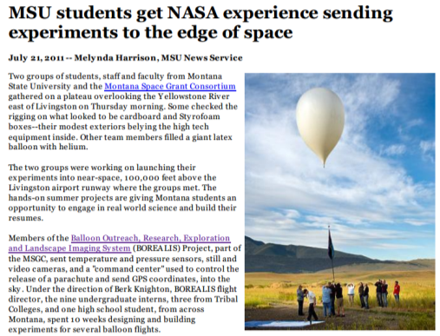
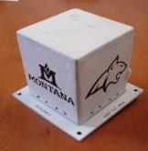
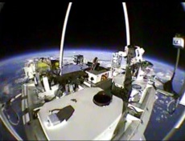
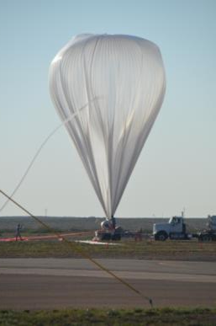
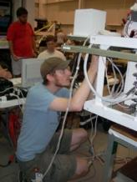
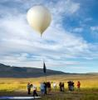
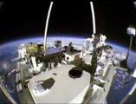
Technical Readiness Level (TRL-5)
Step 3 – Demonstrate as Flight Hardware on High Altitude Balloons
NASA Education Office funds the development of the computer into flight hardware for demonstration on high altitude balloon systems, both in Montana and at NASA.
Computer
Timeline of Activity at MSU
Justin Hogan (Ph.D., EE from MSU, 2014) prepares payload.
Proof of Concept
Prototype Development & Cyclotron Testing
High Altitude Balloon Demos
(2008-2010)
(2010-2012)
(2011-2013)
2008
2009
2010
2011
2012
2013
2014-15
2016
2017

Slide 22
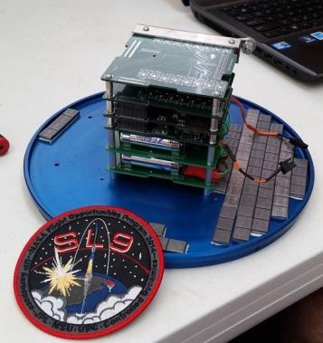
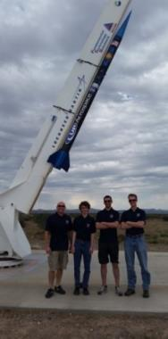
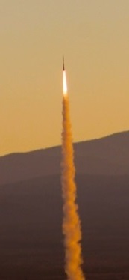
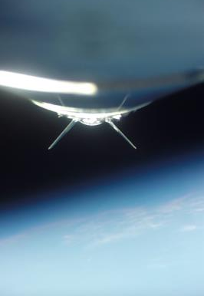
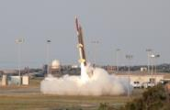
Technical Readiness Level (TRL-6)
Step 4 – Demonstrate as Flight Hardware on a Sounding Rocket
NASA OCT & FOP fund the demonstration of the computer system on sounding rocket.
Flew on UP Aerospace SpaceLoft-9 in Oct 2014. Upcoming flight at Wallops in Mar-16.
Computer
Timeline of Activity at MSU
Proof of Concept
Prototype Development & Cyclotron Testing
High Altitude Balloon Demos
Sounding Rocket Demo
(2008-2010)
(2010-2012)
(2011-2013)
(2012-2016)
2008
2009
2010
2011
2012
2013
2014-15
2016
2017

Slide 23
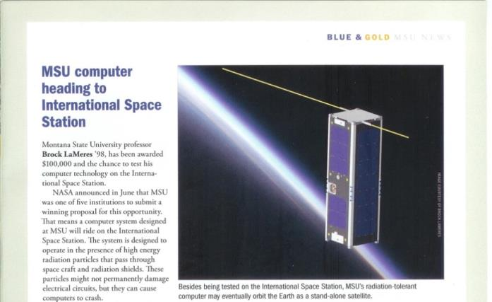
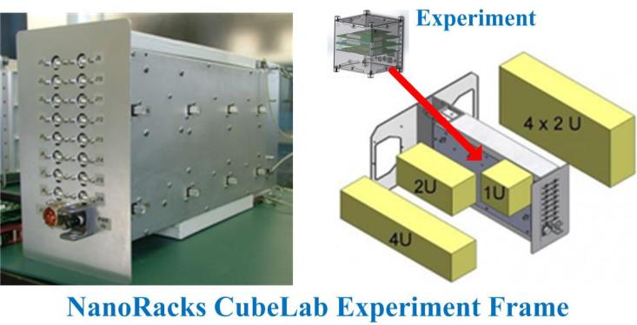
Technical Readiness Level (TRL-7)
Step 5 – Demonstrate on the International Space Station
NASA EPSCoR funds the demonstration of computer system on ISS
Timeline of Activity at MSU
Proof of Concept
Prototype Development & Cyclotron Testing
High Altitude Balloon Demos
Sounding Rocket Demo
ISS
Demo
(2008-2010)
(2010-2012)
(2011-2013)
(2012-2016)
(2014-2016)
2008
2009
2010
2011
2012
2013
2014-15
2016
2017

Slide 24
Technical Readiness Level (TRL-8)
Step 6 – Demonstrate as a Stand-Alone Satellite
NASA SmallSat Technology Partnership Program (SSTP) funds the development of a stand-alone satellite for LEO mission.
This work is being conducted through a partnership between MSU & GSFC.
Artix-7 Implementation
Re-using Avionics from FIREBIRD-II
Timeline of Activity at MSU
Proof of Concept
Prototype Development & Cyclotron Testing
High Altitude Balloon Demos
Sounding Rocket Demo
ISS
Demo
Satellite
Demo
(2008-2010)
(2010-2012)
(2011-2013)
(2012-2014)
(2014-2016)
(2014-2017)
2008
2009
2010
2011
2012
2013
2014-15
2016
2017

Slide 25
Where We Are Today
1. Engineering Unit Will be Complete by September-15
Selected #2 by 2015 CubeSat Launch Initiative
Remaining Work
Build & Qualify Flight Units
Deliver to Pad

Slide 26
Thank You
Questions

Slide 27
Reference
- Europa Clipper Comprehensive FPGA Risk Reduction, Task Lead: Greg Allen, Radiation Effects Group, Jet Propulsion Lab CO-I: Doug Sheldon, 514 Technical Staff, Jet Propulsion Lab Date: April 21, 2014

